Slide 1


Machine Learning in Practice
Kyle Spurlock
11/16/2021

Slide 2
Finding Data
Myriad of ways to get data for machine learning applications
Let somebody else collect it:
UCI Repository
Kaggle
Collect it from your own projects or other applications:
Easy to find pre-made software to interact with API’s

Slide 3
Data Collection from an API
Can just collect data manually for web-applications that use REST API.
Process further simplified by packages that process API requests for you:
Twitter: Tweepy library
Google Images/any image repository: Google-Image-Search library
Spotify: Spotipy library
Likely any online data source you can think of probably has a Python library to interact with it.

Slide 4
Twitter Data
For most API’s, all that is usually required to get started is some access keys:
For Twitter’s case can get them here: https://developer.twitter.com/en
What I’ve used this for in COVID-19 related research:
Finding connections between users that tweet something about COVID-19.
Recording geographical information for users.
Since there is no visibly extraneous connections for these samples, can use clustering to find associations.

Slide 5
Twitter Data and Clustering
Demonstration
Features required:
ID, which needs to be encoded into a discrete value
Can turn this into an adjacency matrix of users that shows the connections between them.
The weight or distance between two users is defined as how nested they are in each other’s networks.

Slide 6
Twitter Features
User
1
2
3
4
User 1 | User 2 | Weight
1 | 2 | 3
2 | 4 | 2
3 | 2 | 3
4 | 1 | 1
 | 1 | 2 | 3 | 4
1 | - | 3 | 0 | 1
2 | 3 | - | 3 | 2
3 | 0 | 3 | - | 0
4 | 1 | 2 | 0 | -
Weighted Adjacency Matrix
Vertex list
Edge list

Slide 7
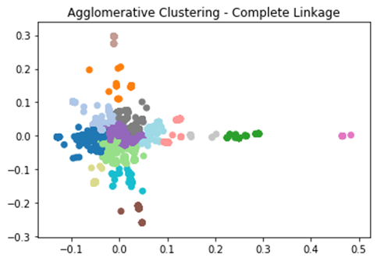
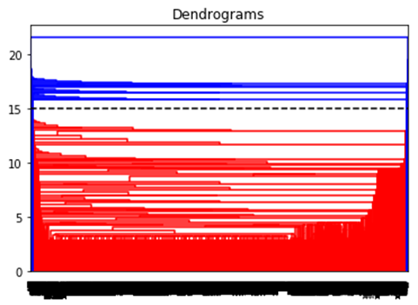
Agglomerative Hierarchical
Recursively merge all samples into clusters until they are all within one cluster.
Complete linkage merges based on farthest two samples in a cluster.
Can discover optimal number of clusters based on biggest gap in mergers.

Slide 8
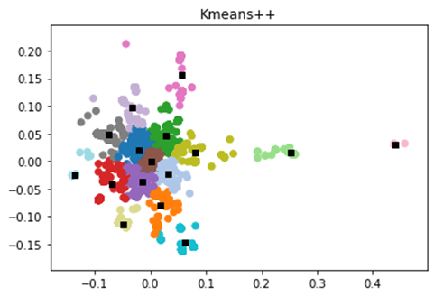
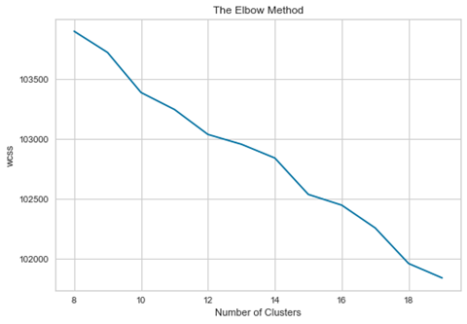
K-Means++
Centroid-based, randomly select K centre’s to cluster samples around.
K-Means++ utilizes a probability function to find next centroids.
Find the optimal number of clusters via WCSS aka “The Elbow Method”.
Elbow point

Slide 9
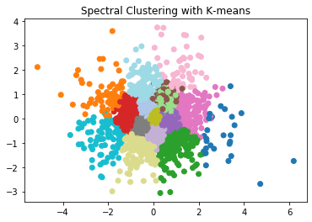
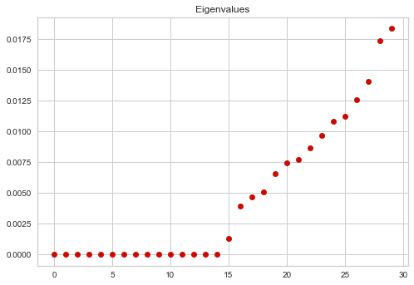
Spectral Clustering (with K-Means)
Clustering on the eigenvectors of a graph’s Laplacian:
L = D (diagonal) – A (adjacency)
Can find how many clusters for algorithms like K-Means by finding the “spectral gap” in the eigenvalues

Slide 10
Centrality
Tells us who are the most connected or the most “important” individuals in the network.
Closeness
Based on inverse of average distance, kind of density based
Degree
What individuals have the most connections?
PageRank
Degree centrality, but also considers the child connections from a root node.
User (Centrality Score)
Closeness | Degree | PageRank
26 (0.1615) | 8 (0.0112) | 8 (0.00194)
54 (0.1557) | 15 (0.011) | 62 (0.00189)
13 (0.154) | 10 (0.011) | 21 (0.00189)
43 (0.1533) | 56 (0.011) | 67(0.00188)
21 (0.1524) | 97 (0.0109) | 56 (0.00187)

Slide 11
Twitter Data and Clustering - Geographic
With Evolutionary Clustering

Slide 12
Twitter Data and Clustering – Geo
Similar setup to the last usage, just considering geographical data now.
Required more complicated techniques to extract relevant information.
Most people on Twitter rarely have geotag enabled.
Can extract more features from the location in their bio instead.
A “city, state” string was converted into latitude and longitude using a US cities database from SimpleMaps.

Slide 13
Twitter Features – Part 2
Most important pre-processing steps:
Matching city/state with latitude and longitude
Encoding tweet timestamps from datetime

Slide 14
Evolutionary Clustering
Like normal clustering, but the clusters evolve with respect to time.
That’s why we need the timestamp.
In this case we are just clustering users who tweeted something about COVID-19 symptoms.
Consider more/different samples at different time intervals.
Features are just latitude and longitude.
Showcases that it can be simple to augment machine learning algorithms with just small changes.

Slide 15
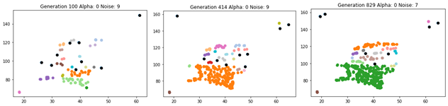
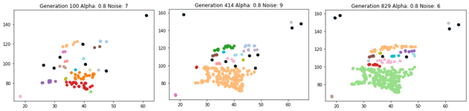
Evolutionary DBSCAN
Based on a dynamic radius measure that changes how clusters are formed.
Alpha here just says:
Low alpha, we want to mostly consider present info
High alpha, we want to consider mostly past info

Slide 16
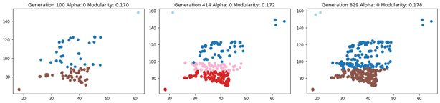
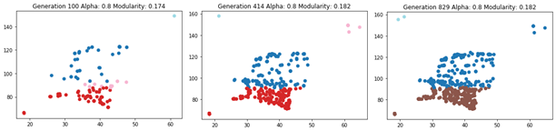
Evolutionary Louvain Method
Louvain Method tries to cluster the network by maximizing a quantity known as Modularity.
It’s greedy and expensive, but it doesn’t require us to specify the number of clusters. (Big bonus for this application)
Here we apply “temporal smoothing” which reinforces past weights.
Makes sure the clusters don’t change too significantly from generation to generation.

Slide 17
Regression Applications

Slide 18
Regression
Regression is a simple but powerful tool for predicting continuous targets.
Has a lot of additional usages:
Feature selection/importance (coefficients)
Computer vision
Explainability
Performed more work dealing with COVID-19 data.
Didn’t have to collect the data this time, but doable.
Can we predict things like confirmed cases for the future using knowledge we have right now?

Slide 19
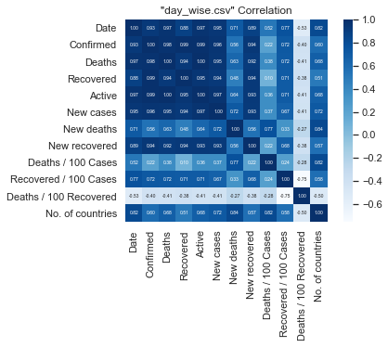
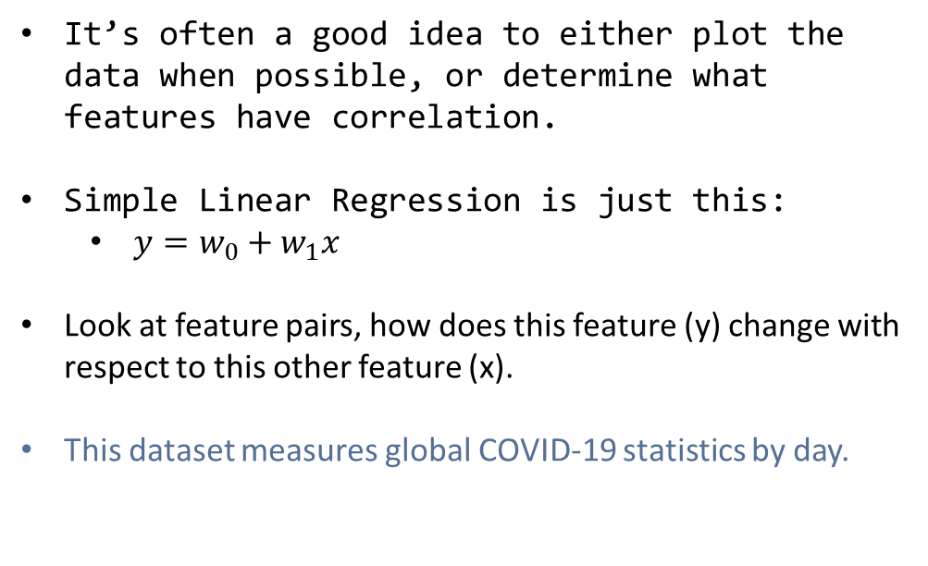
Simple Linear Regression (SLR)
It’s often a good idea to either plot the data when possible, or determine what features have correlation.
Simple Linear Regression is just this:
$y=w_{0}+w_{1}x$
Look at feature pairs, how does this feature (y) change with respect to this other feature (x).
This dataset measures global COVID-19 statistics by day.

Slide 20
Simple Linear Regression (SLR)
Common ways to measure how effective a regressor model is:
MSE
MAE
Coefficient of Determination (r²)
r² tells us how well our model learns the variance of the samples.
SLR is often very good for a lot of cases, but in some cases like (c) or (d), there is no linear relationship.

Slide 21
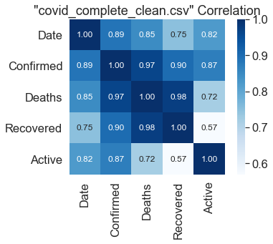
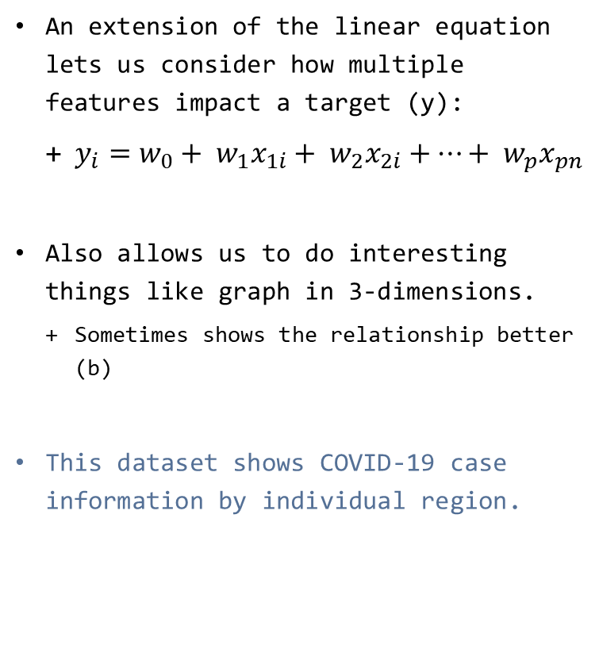
Multiple Linear Regression (MLR)
An extension of the linear equation lets us consider how multiple features impact a target (y):
$y_{i}=w_{0}+ w_{1}x_{1i}+ w_{2}x_{2i}+…+ w_{p}x_{pn}$
Also allows us to do interesting things like graph in 3-dimensions.
Sometimes shows the relationship better (b)
This dataset shows COVID-19 case information by individual region.

Slide 22
Regularization
Just like for classification, often the score of a model does not determine how effective it will be in practice.
In classification problems, class imbalance can skew predictions on unseen data.
In regression, we want to leave the model with some variability for future samples.
Otherwise, it will become “overfitted” to the training data.
Regularization helps with this by penalizing the model through its coefficients.

Slide 23
Regularization with MLR
LASSO shrinks coefficient weights towards 0.
Often considered a very effective feature selection method.
Ridge shrinks coefficients towards each other.
Reduces collinearity (features are linearly inferable).
Elastic Net combines both to reap both benefits.
This dataset shows COVID-19 case information by individual region.

Slide 24
Polynomial Regression
Essentially, a specialized MLR.
Converts features into polynomials of varying degrees.
Allows for polynomial relationships between features to be found related to target(s).
Similar rules of regularization also can be applied here.
This dataset shows COVID-19 case information by individual region.

Slide 25
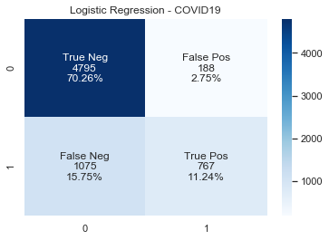
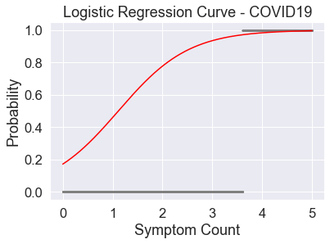
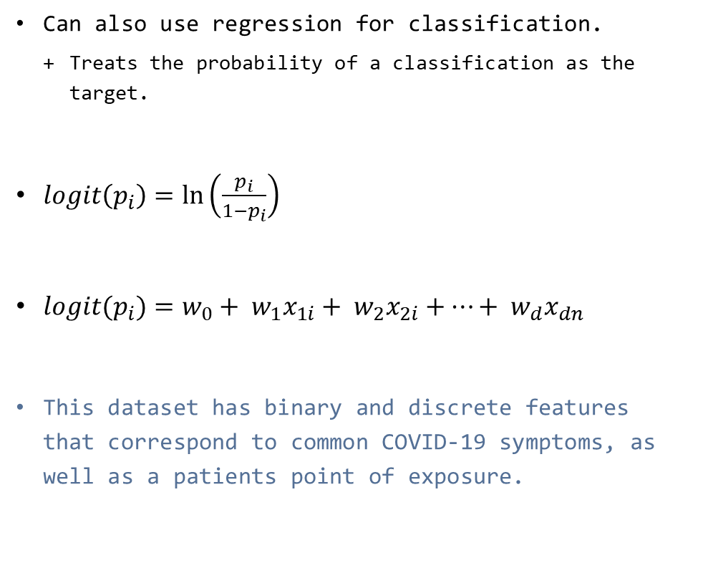
Logistic Regression
Can also use regression for classification.
Treats the probability of a classification as the target.
$logit\left(p_{i}\right)=\ln\left(\frac{p_{i}}{1−p_{i}}\right)$
$logit(p_{i})=w_{0}+ w_{1}x_{1i}+ w_{2}x_{2i}+…+ w_{d}x_{dn}$
This dataset has binary and discrete features that correspond to common COVID-19 symptoms, as well as a patients point of exposure.

Slide 26
Neural Networks

Slide 27
Collecting Image Data for CNN
Like mentioned earlier, it is easy to source data to test on a CNN.
https://cse.google.com/cse/all
https://console.cloud.google.com/apis/dashboard
https://pypi.org/project/Google-Images-Search/
Biggest concern once you have images is how to preprocess them?
File format
Dimensions
Colour channels

Slide 28
Feature Engineering for ANN
Part of my capstone project was spent on training a neural network to play the game Snake.
What kinds of features are required to describe the environment to the model?
Position
Direction to food
Obstacles nearby?

Slide 29
Feature Engineering for ANN
What kinds of features are required to describe the environment to the model?
Collected 28,784 of these samples by just randomly generating moves.

Slide 30
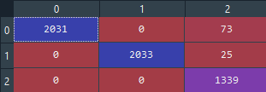
Feature Engineering for ANN
Roughly 97% accuracy on a 20% test size.
Still not perfect, but it has some good moves!

Slide 31
Generating Your Own Data

Slide 32
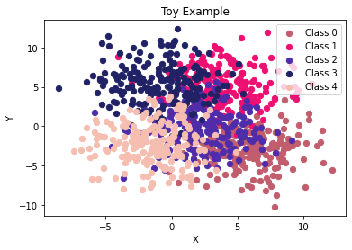
Generating Your Own Data
Lastly, sometimes it is helpful to just create some dummy data to work with.
Commonly referred to as toy examples
Can be just as easy as pulling samples from a distribution and clustering them to find a class.

Slide 33
Any questions?

Slide 34
Thank you!

